Slide 1

Intro to
Machine Learning
Advanced Track Workshop #2:
Multi-layer Neural Networks
ACM AI
Slides: https://tinyurl.com/aiadvanced2

Slide 2
Sign in Here!
ACM AI

Slide 3
Resources
ACM AI
Slides: https://tinyurl.com/aiadvanced2
Github: github.com/uclaacmai/advanced-track-spring18
Colab: colab.research.google.com
Membership Portal Code: nncode2

Slide 4
Overview and Logistics
ACM AI

Slide 5
Advanced Track Tentative Schedule
ACM AI
Week 4: Intro to Neural Networks
Week 5: Multilayer Neural Networks
Week 6: Intro to Convolutional Neural Networks
Week 7: Application of CNNs
Week 8: Intro to Recurrent Neural Networks
Week 9: Application of RNNs
Every Friday 5:30 - 7:00 PM in Eng VI Rm 289

Slide 6
Today’s Contents
ACM AI
Theory/Intuition: multi-layer neural networks
Implementation in TensorFlow
Segue into Convolutional Neural Networks

Slide 7
ACM AI
Questions?

Slide 8
2. Multi-layer Neural Networks
ACM AI

Slide 9
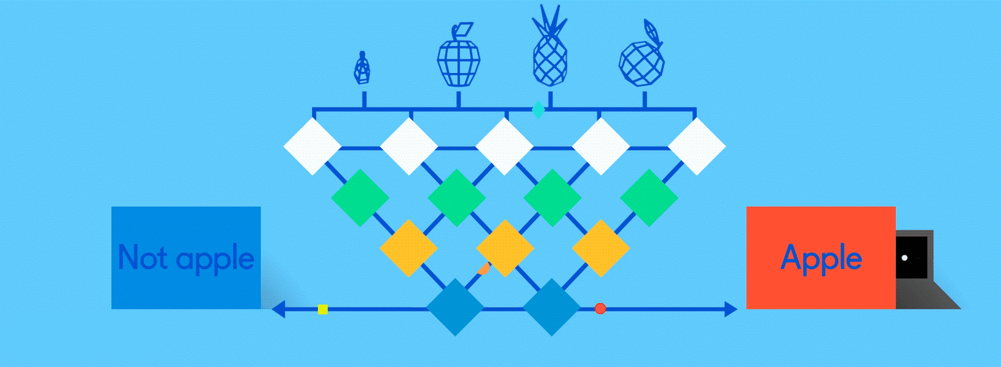
Multilayer Neural Networks
ACM AI
Uses combinations of Logistic Regressions
Mostly used for classification

Slide 10
Components of a Multilayer Neural Network
ACM AI
Perceptrons
Activation Function
Loss Function
Optimization

Slide 11
Perceptron
ACM AI
Building block of the neural network
Essentially a logistic regression with multiple aggregated inputs wrapped with an activation function

Slide 12
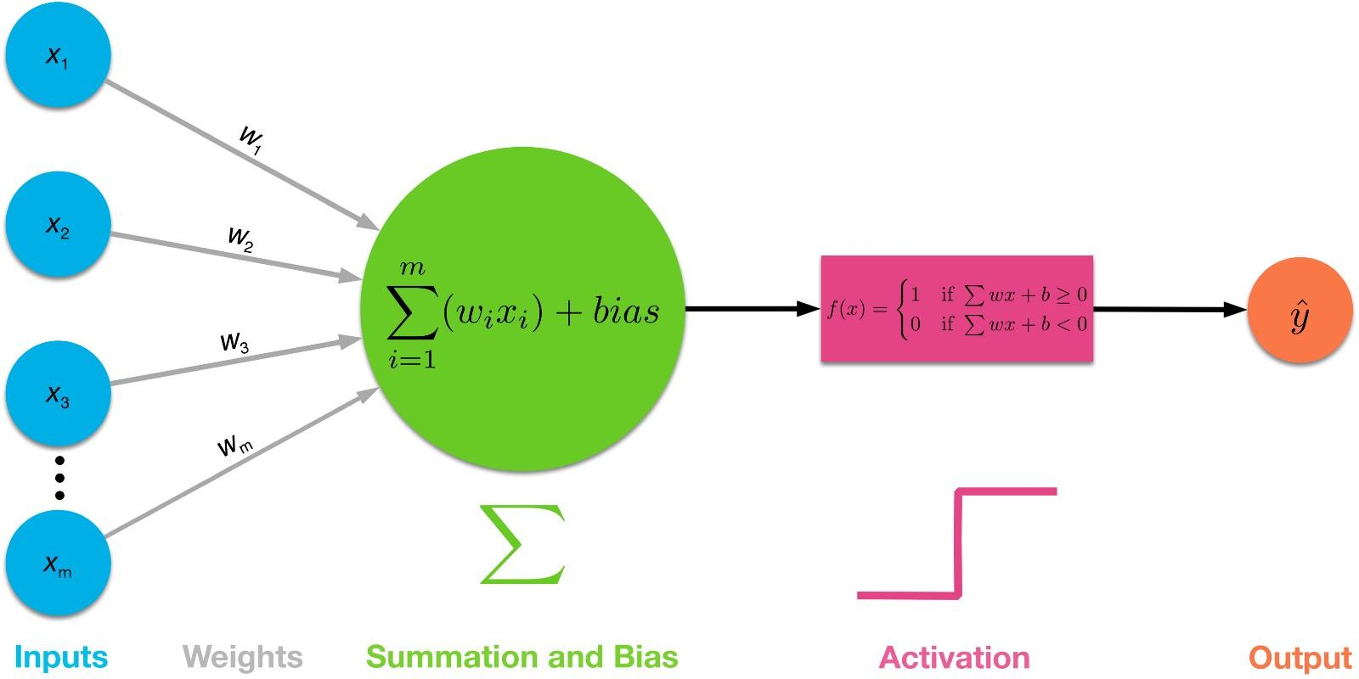
Perceptron
ACM AI
Input values or One input layer
Weights and Bias
Net sum
Activation Function

Slide 13
Activation Function
ACM AI
This function is used to convert the output to a probability classification
This output can be either
0-1 => ReLu (Rectified linear Units) or
0-9 => Softmax

Slide 14
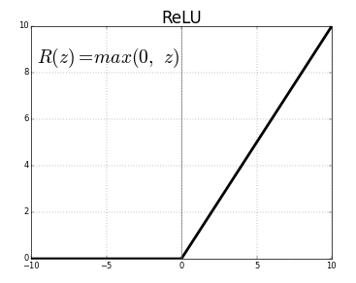
Activation Function - ReLu
ACM AI
Used in hidden layers within individual perceptrons
Used in most modern Neural Networks
Shown to be the most effective activation function
Notes:
Why ReLu
sparsity
ess vanishing gradient

Slide 15
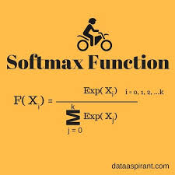
Activation Function
ACM AI
This is used in the output layers
Output is from 0-9

Slide 16

Multiple Layers
ACM AI

Slide 17

Multiple Layers
ACM AI

Slide 18
Why Multiple layers?
ACM AI
Neuron nodes stacked in between inputs and outputs,
Allows neural networks to learn more complicated features
More accurate predictions

Slide 19
Optimization
ACM AI
We optimize the weights and biases so that the prediction is more accurate through the next iteration
Based on a Loss/Objective Function
Cross Entropy Loss Function
Our optimization method is gradient descent

Slide 20
Gradient Descent
ACM AI
Loss function vs. Weight/Biases variable
We find the minima of a Loss function vs. Weights/Biases variable graph, then change the variables to converge towards the minima
Calculates gradient (direction vector) of the error function with respect to the neural network weights

Slide 21
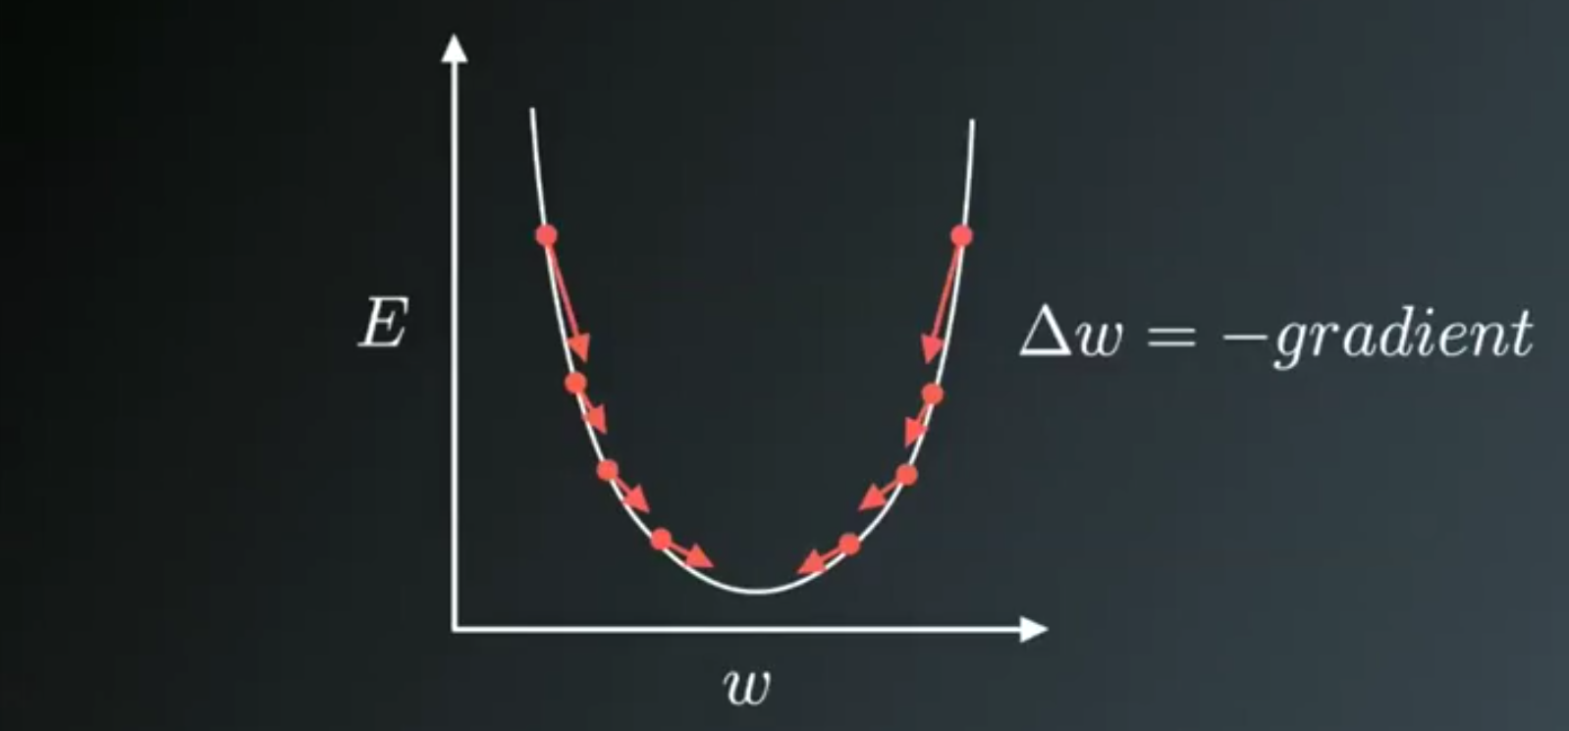
Gradient Descent
ACM AI

Slide 22
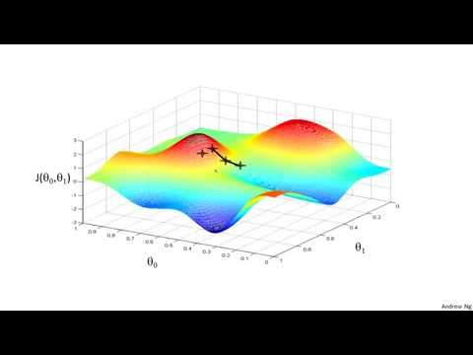
Gradient Descent
ACM AI

Slide 23
Gradient Descent
ACM AI
A Gradient is simply a vector which is a multi-variable generalization of a derivative
Calculated using partial derivatives
Gradient is represented by a Jacobian Matrix — which is simply a Matrix consisting of first order partial Derivatives(Gradients)

Slide 24
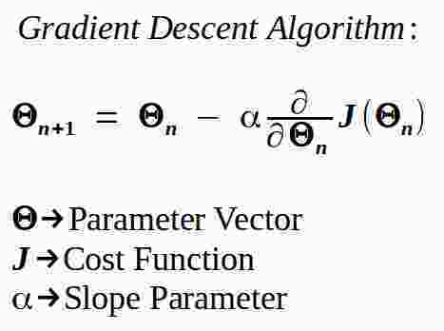
Gradient Descent Formula
ACM AI

Slide 25
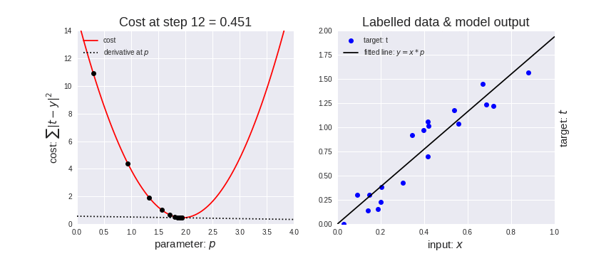
GD Example in Linear Regression Model
ACM AI

Slide 26
ACM AI
Questions?

Slide 27
3. TensorFlow Implementation
ACM AI

Slide 28
Today’s Contents
ACM AI
Implement the architecture covered in previous slide
slowly walking through the code
Train on MNIST dataset
note improvements over logistic regression

Slide 29
ACM AI
Questions?

Slide 30
4. Moving Forward
ACM AI

Slide 31
Limitations?
Neural networks are really efficient for extremely complex tasks
Common misconception:
“If I want my model to work better, I’ll just keep adding layers, and keep adding nodes”
More Complex =/= Better Model

Slide 32
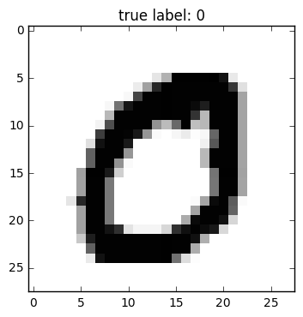
Computer Vision
Neural networks don’t utilize relative spatial information
Images have pixels in that appear in groups or patterns
Forcing pixel data into a straight neural network will instead hinder the model’s potential

Slide 33
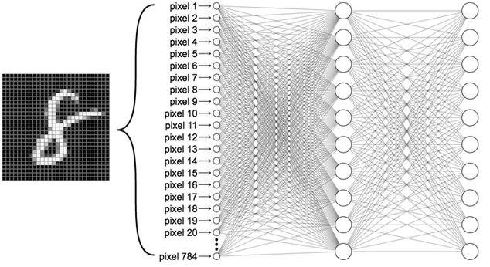

Slide 34
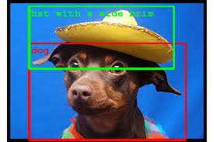
Solution?
Find a way to maintain spatial relation
Detect patterns of different shapes, sizes, and color
New goals: object detection, localization, etc.

Slide 35

Convolutional Neural Networks (CNNs)

Slide 36
High Level Overview of CNNs
Instead of feeding each individual pixel as a data point, we use “filters” or windows to parse across the image
The windows are of different sizes, intended to try and find higher level patterns, rather than specific pixel values
These “filters” will ultimately learn to pick up specific patterns
Still utilizes a neural network, aka fully connected layer

Slide 37
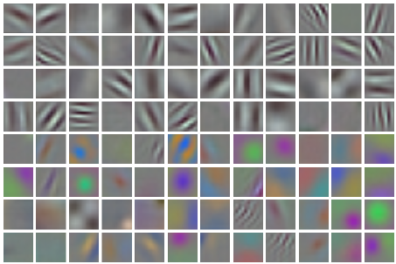
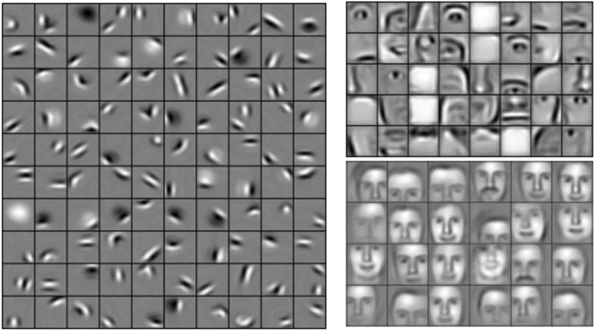
High Level Overview of CNNs

Slide 38
ACM AI
Questions?

Slide 39
5. Upcoming Events
ACM AI

Slide 40
Advanced Track Meeting Next Week
ACM AI
When: Friday, May 11th from 5:30 - 7:00 PM
Where: Engineering VI - Room 289
Next week, we’ll be continuing with convolutional neural networks

Slide 41
Beginner Track Meeting Next Week
ACM AI
When: Friday, May 11th from 4:00 - 5:30 PM
Where: Engineering VI - Room 289
If you felt like today’s lesson was too fast paced, check out our Beginner Track workshops!
We’re currently going over the code behind logistic regression

Slide 42

Other ACM Events
ACM AI
Startups x Developers: May 16th, 6:00 - 8:00 PM

Slide 43
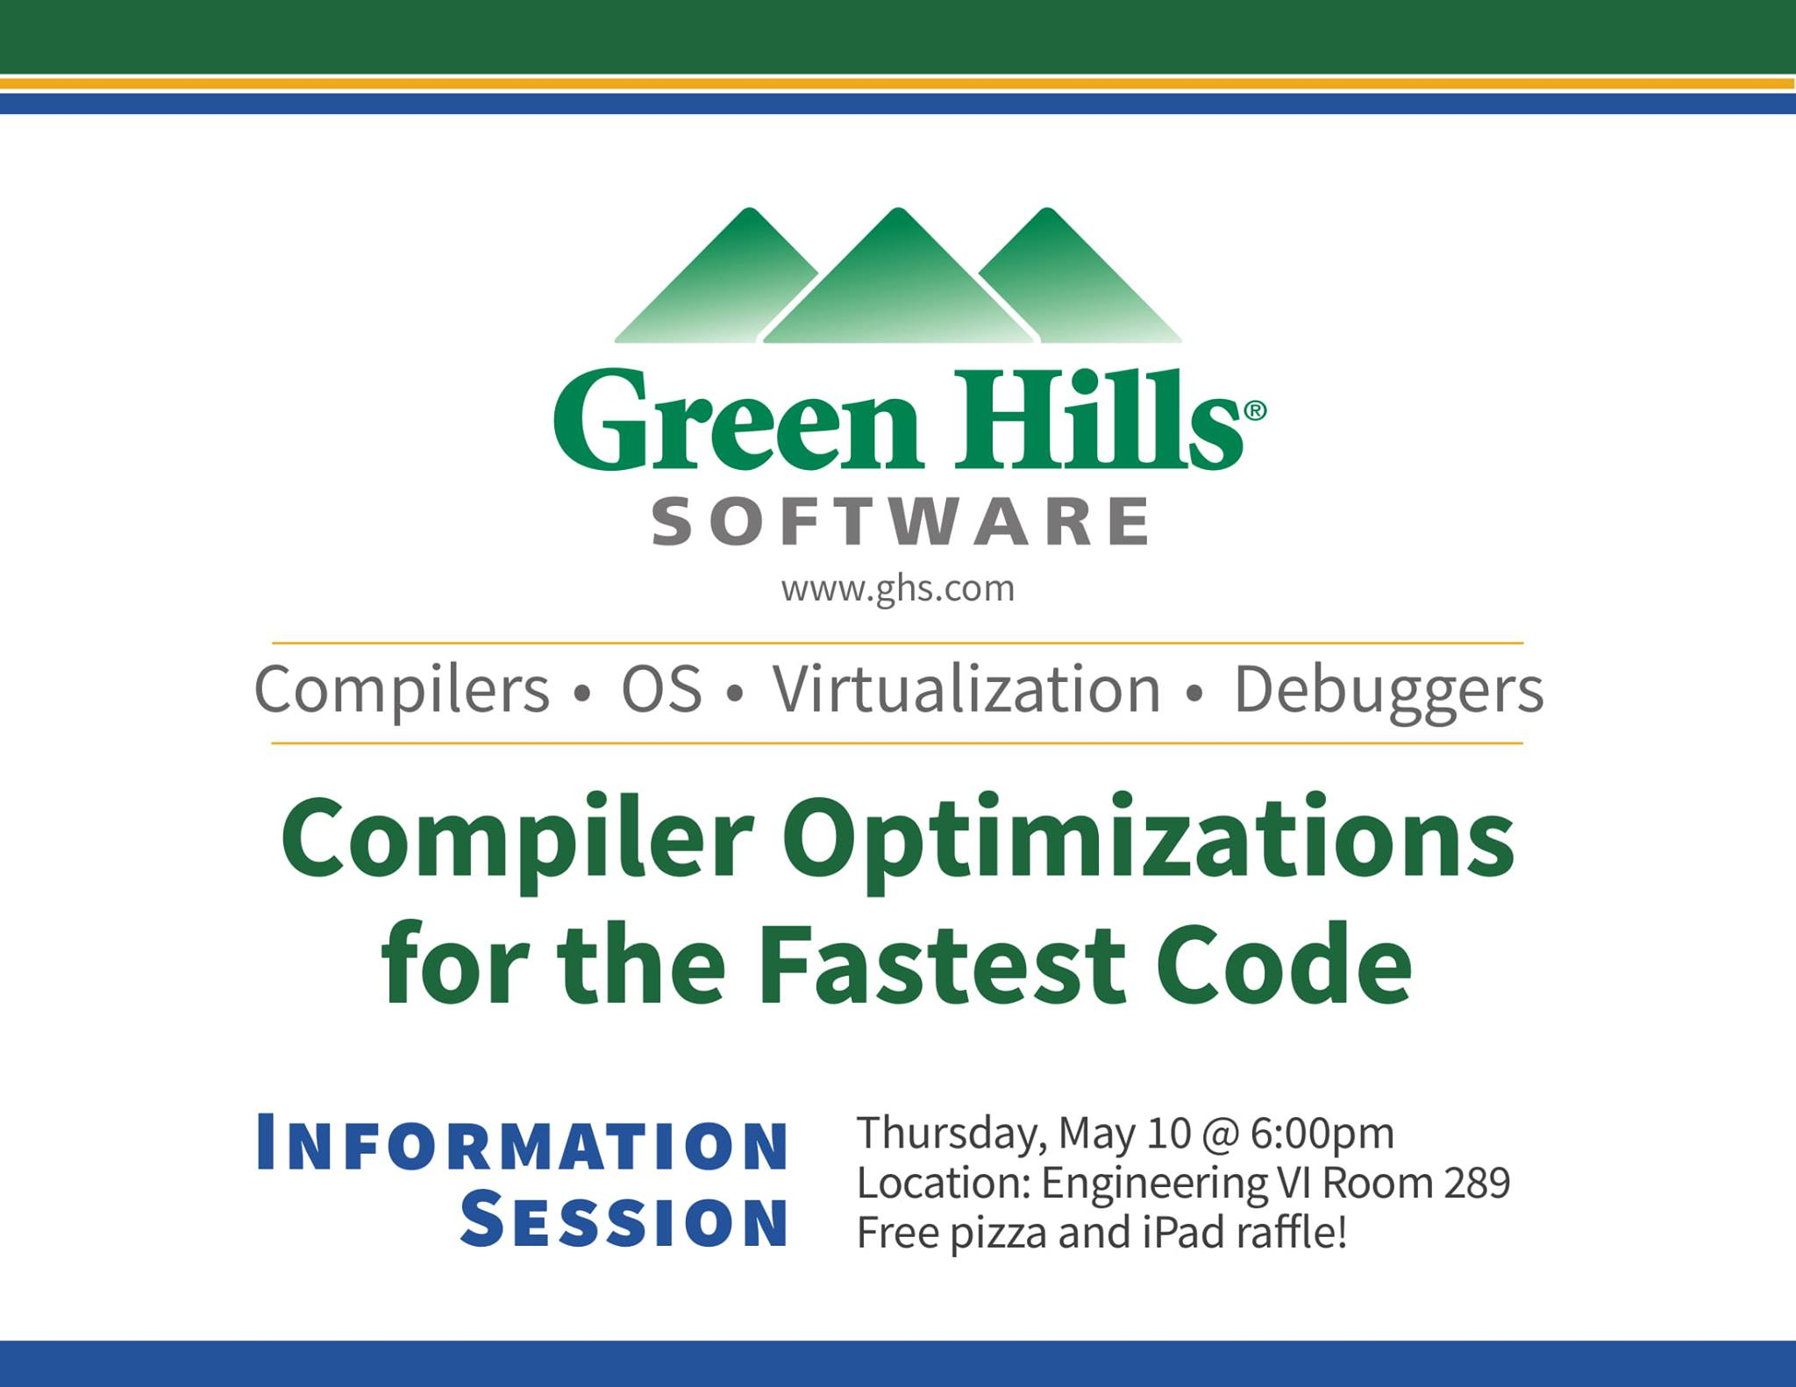
Other ACM Events
ACM AI
Compiler Optimization Tech Talk: May 10th, 6:00 - 7:00 PM

Slide 44
Please Fill Out Our Feedback Form!
ACM AI

Slide 45
Thank you all for coming!
Coming up next week:
Introduction to Convolutional Neural Networks
Join our Facebook group
ACM AI

